Slide 1
Tec(h)tonic Race and Ethnicity: Conceptual Structuration of Census Data
Joseph T. Tennis

Slide 2
Tec(h)tonic Race and Ethnicity: Conceptual Structuration of Census Data
Joseph T. Tennis

Slide 3
Outline
Census Data
Enumerating Race and Ethnicity
Conceptual Structuration
Toward the Paper

Slide 4
Census Data

Slide 5
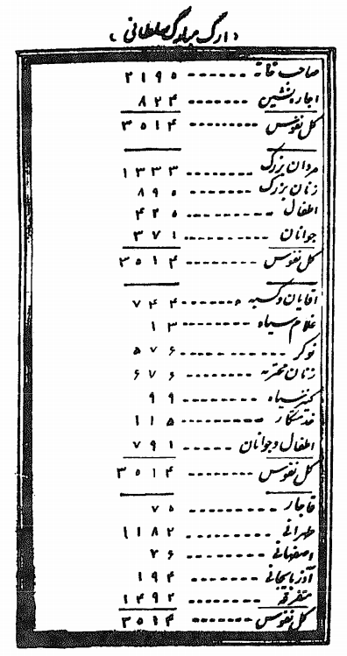
Census Data
Tehran Census 1869

Slide 6
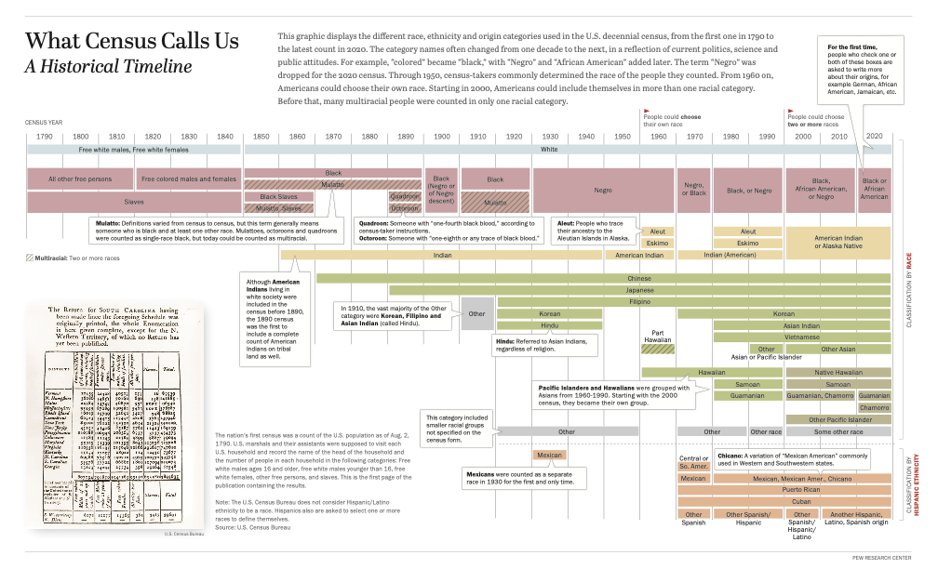
Census
Data

Slide 7
Census Data
Drawn from Ann Morning’s data 1995-2004 (2000 round) censuses:
1. How widespread is census enumeration by ethnicity, in global terms?
2. Among national censuses that do enumerate by ethnicity, what approaches do they take, in terms of both their question and answer formats?
3. What geographic patterns, if any, do ethnic enumeration practices follow?
4. How does the United States' census approach to ethnic enumeration compare to those that are prevalent elsewhere? (pg. 240)

Slide 8
Census Data

Slide 9
Enumerating Race and Ethnicity

Slide 10
Enumerating Race and Ethnicity
One Country | Another Country Equivalence | Same Country
Race | Ethnicity
Ethnic Origin
Nationality | Ancestry | Citizenship
Ancestry
Indigenous Group
Tribal Group
Aboriginal Group

Slide 11
Enumerating Race and Ethnicity
“Despite the fluidity between the conceptual borders of ethnicity, race, and nationality, at their cores they share a common connotation of ancestry or "community of descent" (Hollinger 1998). Each concept relies on a different type of proof or manifestation of those shared roots - ethnicity discerns it in cultural practices or beliefs (e.g., dress, language, religion), race in perceived physical traits, and nationality through geographic location - yet they all aim to convey an accounting of origins or ancestry. As a result, in the research to be described I have included all three of these terms - and others - as indicators of one underlying concept of origins.” (Morning, 2008 pg. 242)

Slide 12
Enumerating Race and Ethnicity
1 . Enumeration for political control (compter pour dominer),
2. Non-enumeration in the name of national integration (ne pas compter au nom de l’integration nationale),
3. Discourse of national hybridity (compter ou ne pas compter au nom de la mixité), and
4. Enumeration for antidiscrimination (compter pour justifier V action positive). (Rallu et al., 2004 via Morning 2008).

Slide 13
Enumerating Race and Ethnicity
Common yet different?
How does this inform classification theory?

Slide 14
Conceptual Structuration

Slide 15
Conceptual Structuration
“Based on this sample, it appears that nations in the Americas and in Oceania are most likely to enumerate by ethnicity, while those in Europe and Africa are the least likely. Among the countries that do practice census ethnic classification, the term "nationality" is most likely to be used in eastern Europe and the former Soviet Union, while "indigenous status" is most likely to be a concern in the Americas, as is "race.” (Morning, 2008 pg. 263) emphasis mine.

Slide 16
Conceptual Structuration
One Country | Another Country Equivalence | Same Country
Race | Ethnicity
Ethnic Origin
Nationality | Ancestry | Citizenship
Ancestry
Indigenous Group
Tribal Group
Aboriginal Group

Slide 17
Conceptual Structuration
Ethnic Enumeration | Ethnic Enumeration | Ethnic Enumeration
Race | Ethnicity | Do you belong to an indigenous group?
Ethnic Origin | Caste/Ethnicity | Family’s local tribe?
Nationality | Cultural and Ethnic Background | Write tribe code
Ancestry | Ethnic/Dialect Group
Indigenous Group | Ethnic Nationality
Tribal Group | Race or Ethnic Group
Aboriginal Group | Citizenship

Slide 20
Conceptual Structuration
Origin

Slide 21
Conceptual Structuration
Origin
Ethnicity
Nationality
Indigenous/Tribe
Race

Slide 22
Conceptual Structuration
Origin
Ethnicity
Origin
Ethnicity
Nationality
Indigenous/Tribe
Race

Slide 23
Conceptual Structuration
Origin
Ethnicity
Origin
Ethnicity
Race
Nationality
Indigenous/Tribe
Race

Slide 24
Conceptual Structuration
Origin
Power
Belonging

Slide 25
Conceptual Structuration
Dissection (Ranganathan, 1967 pg. 353)

Slide 26
Conceptual Structuration
Lamination (Ranganathan, 1967 pg. 354)

Slide 27
Conceptual Structuration
Denudation (Ranganathan, 1967 pg. 356)

Slide 28
Conceptual Structuration
Loose Assemblage (Ranganathan, 1967 pg. 358)

Slide 29
Conceptual Structuration
Superimposition(Ranganathan, 1967 pg. 359)

Slide 30
Conceptual Structuration
Dichotomy (Ranganathan, 1967 pg. 360)
Decachotomy (Ranganathan, 1967 pg. 362)
Polychotomy (Ranganathan, 1967 pg. 363)

Slide 31
Conceptual Structuration

Slide 32
Conceptual Structuration
1 . Enumeration for political control (compter pour dominer),
2. Non-enumeration in the name of national integration (ne pas compter au nom de l’integration nationale),
3. Discourse of national hybridity (compter ou ne pas compter au nom de la mixité), and
4. Enumeration for antidiscrimination (compter pour justifier V action positive). (Rallu et al., 2004 via Morning 2008).

Slide 33
Toward the Paper
Examine case studies for these conceptual structurations and variations thereof.
Document and theorize about links between motivations, categories, and the contours of categories.
Link to literature.

Slide 34
Thank you
Joseph T. Tennis
jtennis@uw.edu
jt tennis = google scholar
josephttennis = twitter

Slide 35
References
Morning, A. (2008). “Ethnic Classification in Global Perspective: A Cross-National Survey of the 2000 Census Round.” Population Research and Policy Review 27(2): 239-272.
Olson, H. (2001). “Patriarchal Structures of Subject Access and Subversive Techniques for Change.” The Canadian Journal of Information and Library Science 26(2/3): 1-29.
Rallu, J.-L., Piché, V., & Simon, P. (2004). Démographie et Ethnicité: Une Relation Ambiguë. In G. Caselli, J. Vallin, & G. Wunsch (Eds.), Démographie: Analyse et Synthèse (pp. 481-515). Paris, France: Institut National d'Etudes Démographiques.
Star, Susan Leigh, and Geoffrey Bowker. 2007. “Enacting silence: Residual categories as a challenge for ethics, information systems, and communication.” Ethics and Information Technology 9: 273–280. https://doi.org/10.1007/s10676-007-9141-7
Ranganathan, S. R. (1967). Prolegomena to Library Classification. 3rd Ed. Madras: Asia Publishing House.
Tennis, J. T. (2018). "Intellectual History, History of Ideas, and Subject Ontogeny." (2018). Challenges and Opportunities for Knowledge Organization in the Digital Age. Proceedings of the 15th International ISKO Conference 9-11 July 2018, Porto, Portugal. Advances in Knowledge Organization, Vol 16. 308-313.

